Slide 1
The Index Poisoning Attack in P2P File Sharing Systems
Shumanski, Andrei
Trigonakis, Vasileios

Slide 2
Agenda
P2P File Sharing
Systems under Evaluation
Types of Attacks
Data Gathering Methodology
Measurements & Results
Conclusions

Slide 3
P2P File Sharing
One of the most important applications in the Internet
Huge cost for the “copyright industry”
Sharing systems under attack

Slide 4
Terminology
Title is a specific song or video
A given title can have many different versions
Each version has one identifier (hash of the version)
Multiple copies of identical versions in the system
Advertisements about the copies
Keyword search is used

Slide 5
Agenda
P2P File Sharing
Systems under Evaluation
Types of Attacks
Data Gathering Methodology
Measurements & Results
Conclusions

Slide 6
Systems under Evaluation
Overnet:
used in eDonkey2000
DHT-based file sharing system
FastTrack:
two-tier unstructured file sharing system
index distributed over a small fraction of the nodes

Slide 7
Agenda
P2P File Sharing
Systems under Evaluation
Types of Attacks
Data Gathering Methodology
Measurements & Results
Conclusions

Slide 8
Types of Attacks
Pollution attack: corrupting the targeted content, rendering it unusable, and then making this polluted content available for sharing in large volumes.
Resource intensive attack
Index poisoning attack: inserting massive numbers of bogus records into the index. (i.e. randomly chosen file identifiers)
Structured & unstructured systems
Non resource intensive attack

Slide 9
The Index Poisoning Attack
Typically, no authentication for the files’ advertisements
Attack by falsely advertising copies of the targeted titles
Possible types:
non-existing, random ids (mostly used)
non-existing IPs
unavailable service port numbers

Slide 10
Index poisoning attack in FastTrack
Decentralized & unstructured (two-tier)
Two classes of nodes:
Ordinary Nodes (ONs)
Super-Nodes (SNs)
SN overlay - long-lived TCP connections
Index kept by the SNs
Attack by:
inserting bogus records into the indexes of the SNs

Slide 11
Index poisoning attack in Overnet
Based on Kademlia
All nodes equal
UDP messages
Version ids & keyword hashes stored
Attack by:
defining the target keywords and hash them
random id, not derived by some existing file
periodically refresh this information

Slide 12
Agenda
P2P File Sharing
Systems under Evaluation
Types of Attacks
Data Gathering Methodology
Measurements & Results
Conclusions

Slide 13
Data Gathering Methodology
Downloading of files too expensive
Solution:
Harvesting: collect the version ids and publisher node data & create a list of the advertised versions and a list of the distinct copies of each version. Done by:
FastTrack: a crawler
Overnet: inserting a node in the DHT with the target keywords hash as id
Classify the versions (clean, polluted, poisoned)
Determine the pollution and poison levels for the versions and copies

Slide 14
Classifying the Versions
Observation: “Among the users that have at least one version of the title, the large majority of users advertise at most a few versions (Light users) and a relatively small number of users advertise a large number of versions (Heavy users).”
Heuristic:
V → set of all the advertised versions
V_{H} → by heavy users
V_{L} → by light users
V_{X} = V_{H} ∩ V_{L} → polluted versions
V_{H}* = V_{H} – V_{X} → poisoned versions
V_{L}* = V_{L} – V_{X} → clean versions

Slide 15
Poisoning & Pollution Levels
poisoning:
|V_{H}*| / |V|
pollution:
|V_{X}| / |V|
clean:
|V_{L}*| / |V|
poisoning:
pollution:
clean:
C_{u} is the set of copies for version u
Version Levels
Copy Levels

Slide 16
Agenda
P2P File Sharing
Systems under Evaluation
Types of Attacks
Data Gathering Methodology
Measurements & Results
Conclusions

Slide 17
Evaluation of the Heuristic
Overall, the scheme correctly classified more than 96% of the
versions.

Slide 18
Measurements & Results
FastTrack (data set collected by the crawler in April 2005):
Decoyers are 7% of all users but provide 77% of all copies and 73% of all versions
 | # of IPs | # of users | # of copies | # of versions
Decoyer | 624 | 8,683 | 1,183,622 | 443,102
Ordinary | 82,015 | 117,673 | 347,939 | 167,103
Overnet (data set collected by the inserted nodes in June 2005):
Decoyers are 0,2% of all users but provide 58% of all copies and 85% of all versions
 | # of IPs | # of users | # of copies | # of versions
Decoyer | 26 | 27 | 23,771 | 22,678
Ordinary | 12,135 | 12,545 | 17,104 | 3,907

Slide 19
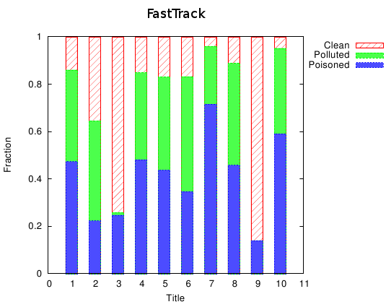
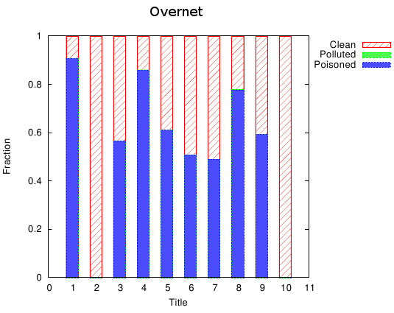
Mesurements & Results - Copies
There are different companies and techniques
Total decoy percentage is up to 95%
Little pollution in Overnet

Slide 20
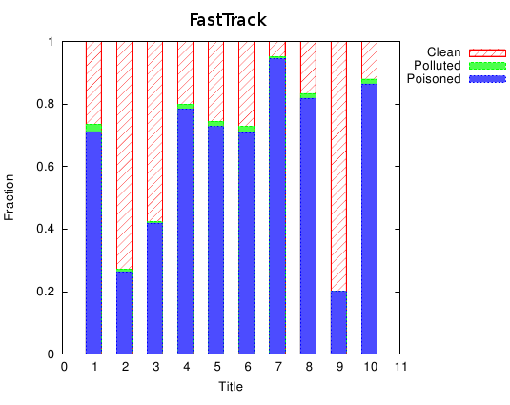
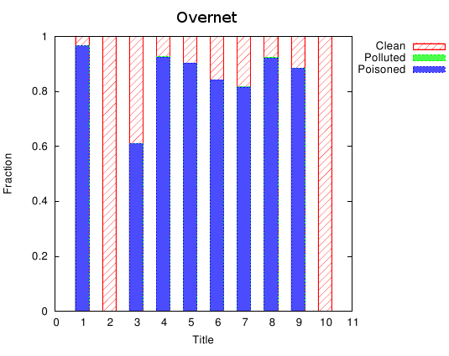
Mesurements & Results - Versions
Majority of versions are poisoned
Poisoning level up to 90%
Versions poison level is higher than copies poison level:
copies of the poisoned versions do not circulate
decoyers make many copies of the same polluted version

Slide 21
DHT Vulnerabilities to Poisoning
Node insertion attack:
Not observed in FastTrack
Observed in Overnet – decoyers’ nodes return random identifiers, prevent users from finding clean versions
Poisoning: DHT vs. Unstructured
Small # of titles → DHT requires less resources
Increasing # of titles → eventually, DHT requires more resources
DDoS attack by exploiting DHT
pointing one node

Slide 22
Defending against Poisoning Attack
Overview of Solutions:
Rating versions and advertisements - forums
Rating sources - blacklists of IP ranges based on reputation

Slide 23
Agenda
P2P File Sharing
Systems under Evaluation
Types of Attacks
Data Gathering Methodology
Measurements & Results
Conclusions

Slide 24
Conclusions
Both structured & unstructured overlays are vulnerable
Proposed solution can detect the polluted and poisoned versions-copies with a good approximation

Slide 25
References
J. Liang, N. Naoumov, KW. Ross, The index poisoning attack in p2p file sharing systems, IEEE INFOCOM, 2006.

Slide 26
The end..
Thank you ☺

